Slide 1



SOCAT
BOOT2ROOT CHALLENGES

Slide 2


Introduction
TRYHACKME WALKTHROUGH
Welcome to this comprehensive TryHackMe walkthrough presentation. It showcases our journey through various boot2root challenges hosted on TryHackMe. Our focus is on privilege escalation, exploiting CVEs, discovering internal ports, and SSH tunneling. We aim to enhance our ethical hacking skills and cybersecurity knowledge through these exercises. Join us as we explore the technical depths of these challenges, discuss the tools and methodologies used, and share our experiences and insights. This walkthrough is a collaborative effort by our dedicated team of cybersecurity enthusiasts.

Slide 3
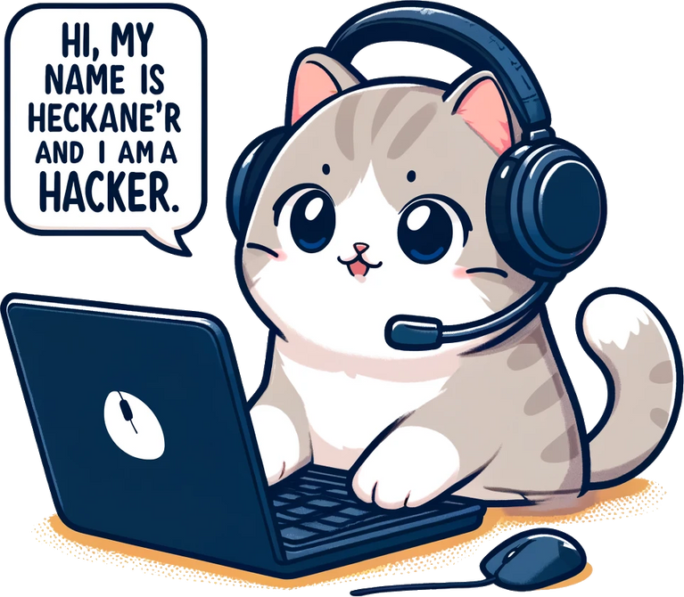



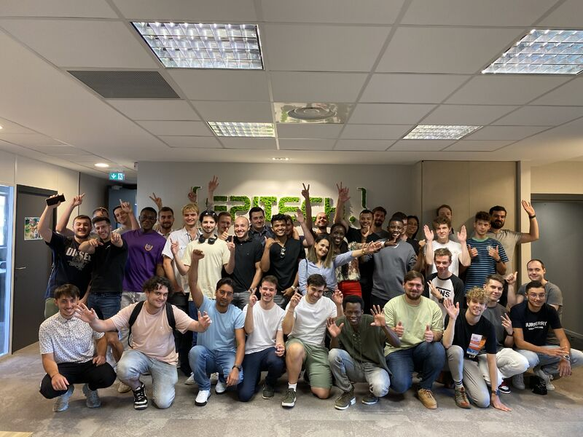
LUCAS FIXARI
Lead Researcher and Exploitation Expert
PIERRE ROCHETTE
Happiness Manager & Theory Expert Student
Our Team
WILLIAM WOZIWODA
THE CROWD
Burp Query Decomposer Specialist
Helping knowledge and
useful sounds

Slide 4

WEB ENUMERATION
Technologies Used
Nmap
nmap -sC -sV <TARGET IP>: Runs default scripts and version detection.
nmap -A <TARGET IP>: Performs OS detection, version detection, script scanning, and traceroute.
nmap -p <PORTS> <TARGET IP>: Scans specific ports.
A powerful network scanner for detecting open ports, services, and potential vulnerabilities.
Gobuster
gobuster dir --wordlist /usr/share/wordlists/rockyou.txt -u http://<TARGET IP>: Brute-forces directories with specified wordlist.
Additional flags: -x php,txt,html,sh,cgi,bak (file extensions), -q (quiet mode).
Web enumeration and
vulnerability
scanning are
critical
first steps
Used for brute-forcing directories on web servers, helping to uncover hidden files and directories
Fuff
ffuf -u http://<TARGET IP>/FUZZ -w /usr/share/wordlists/rockyou.txt -o ffufoutput.txt: Fuzzes directories and saves output to a file.
Fast web fuzzer that allows directory discovery, virtual host discovery and GET and POST parameter fuzzing

Slide 5
ACCESS AND ENUMERATION
Technologies Used
SSH
Secure shell access, which is crucial for remote management of servers
ssh <USER>@<TARGET IP>: Connects to target via SSH.
ssh -i id_rsa <USER>@<TARGET IP>: Uses a specified private key for SSH connection.
Netcat
nc -lnvp <PORT>: Listens on a specified port.
nc <LOCAL MACHINE IP> <PORT>: Connects to a specified IP and port.
Once potential
vulnerabilities
are
identified,
gaining
access
and further
enumeration are the next steps
Known as the "Swiss army knife" of networking, it allows for reading from and writing to network connections
LinPEAS
Local privilege escalation enumeration script to discover misconfigurations and potential paths for privilege escalation
Linux Privilege Escalation Awesome Script

Slide 6
Decoder
DECODING AND DECRYPTION
Technologies Used
For various encoding formats like Base64, hexadecimal, and Base32
Base64: base64 -d
Hexadecimal: xxd -r -p
Base32: base32 -d
John the Ripper
A powerful password cracking tool to break encrypted passwords
john --wordlist=/usr/share/wordlists/rockyou.txt hashes.txt
Decoding and
decryption are
vital for
uncovering
hidden
information
and breaking
through encoded defenses
Steghide
steghide extract -sf <image>.jpg
stegseek <image>.jpg /usr/share/wordlists/rockyou.txt
For extracting data hidden within images
Use stegseek if the password is unknown
GPG
For handling encrypted files
gpg --import .hidden-key
gpg -d -o <file>.xlsx <file>.xlsx.gpg

Slide 7
Hydra
ADDITIONAL TOOLS
Technologies Used
Used for brute-force attacks on login services
hydra -L username.txt -P password.txt <TARGET SERVICE>
Additional flags: -l (known username), -p (known password).
Sqlmap
An automated SQL injection tool that helps in identifying and exploiting SQL injection flaws
sqlmap -u <URL> --dbs
--dbs: Names of the available databases
In addition to core
tools, we employs
several
specialized
tools
Curl
curl -X POST -H "Content-Type: application/json" -d '{"key":"value"}' http://<TARGET IP>:<PORT>/api/<username>
A versatile command-line tool for data transfer, utilized for interacting with web applications via commands
WPScan
wpscan -e u --url http://<TARGET IP>/wordpress -U admin -P /usr/share/wordlists/rockyou.txt
Additional flags: -e u (users), -e p (plugins), -e t (themes), -U <username> (username for brute-forcing), -P <path to wordlist> (path to a password wordlist for brute-forcing).
Specifically for scanning WordPress sites for vulnerabilities

Slide 8

Websites Used
We utilized various online resources to assist with decoding, vulnerability research, and additional cybersecurity tasks.
These resources were instrumental in guiding our walkthroughs, providing critical information, and enhancing our understanding of various cybersecurity concepts and techniques.
Hashes.com: A comprehensive resource for hash decryption.
dcode.fr: An online tool for identifying and decrypting various types of ciphers and codes.
Exploit-db.com: A database of public exploits and proof-of-concept for known vulnerabilities.
Crackstation.net: A powerful online password cracking tool that uses large precomputed hash databases.
Pentestmonkey.net - Reverse Shell Cheat Sheet: A resource for reverse shell commands and techniques.
GTFO Bins: A curated list of Unix binaries that can be exploited by an attacker to bypass local security restrictions.
GPG Documentation: Official documentation for GPG, a tool for secure communication and data storage.
WordPress Reverse Shell Documentation - Hacking Articles: A guide for creating and deploying reverse shells in WordPress environments.
Reverse Shell - Pentester Academy Blog: An article on exploiting Jenkins Groovy script console to gain a reverse shell.
Google Translate: 한국어를 이해하는 데 도움이 될 수 있는 텍스트 번역을 위한 다용도 도구

Slide 9

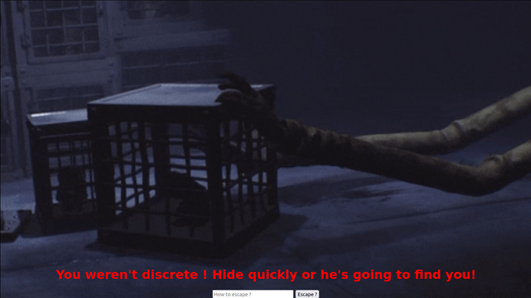
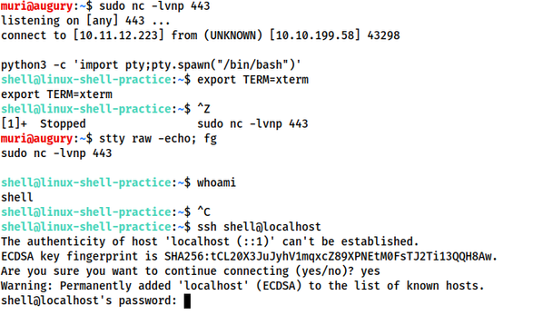
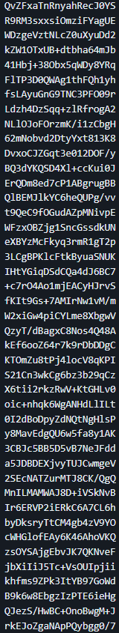
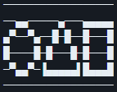
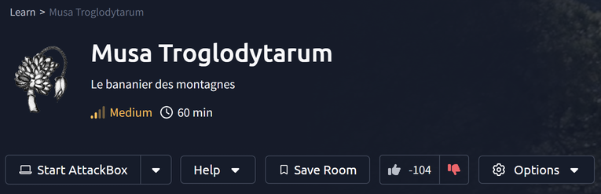
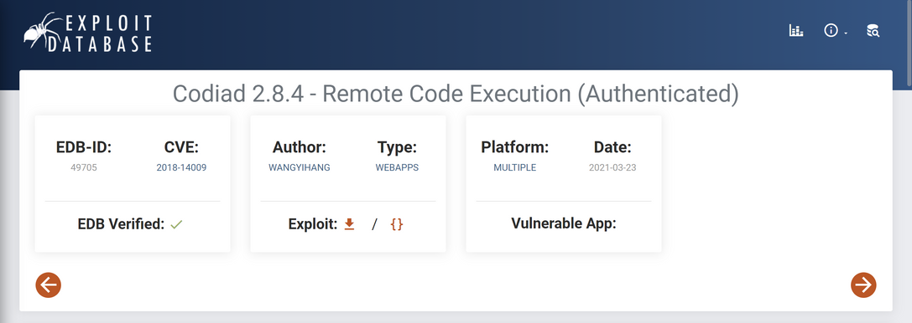
Firewall Bypassing: Many targets had robust firewalls, making initial access difficult. We had to employ advanced techniques to bypass these protections.
Complex CVE Exploits: Some vulnerabilities required detailed research and precise execution. Understanding and leveraging these CVEs was time-consuming but rewarding.
Maintaining stable connections: Maintaining stable connections via SSH tunneling was challenging, especially with network instability.
Decoding Complex Data: Encountering heavily encoded or encrypted data posed significant hurdles. It required the use of multiple tools and methods to decode effectively.
Challenges Faced

Slide 10

Room Ratings
We evaluated each room based on difficulty and learning value, assigning ratings from 0 to 4 stars
ROOM NAME | LUCAS | WILLIAM | PIERRE
ROOM NAME | LUCAS | WILLIAM | PIERRE
TOSS A COIN | ★★★★ | ★★★★ | ★★★★
YER A WIZARD | ★★★★ | ★★★★ | ����
MUSA TROGLODYTARUM | ★★★★ | ★★★★ | ����
SECRETS OF THE MAW | ★★★★ | ★★★★ | ����
THE BINDING OF CYBER | ★★★★ | ���� | ����
DALGONA | ★★★★ | ���� | ����
GRAND LINE | ★★★★ | ���� | ����
SILENCE | ★★★★ | ���� | ����
UN PEPENE | ★★★★ | ���� | ����
AROUND THE WORLD | ★★★★ | ���� | ����
DIABOLICAL BOX | ���� | ���� | ����
PATIENCE | ���� | ���� | ����

Slide 11


Most Useful Information
Here are some critical tips and commands that proved invaluable during our TryHackMe walkthroughs
python3 -c "import pty; pty.spawn('/bin/bash')"
<USER>@<TARGET MACHINE>:~# ^Z
[1]+ Stopped
root@<LOCAL MACHINE>:~# stty raw -echo
<-- fg & enter
<USER>@<TARGET MACHINE>:~#
ssh -R <PORT>:127.0.0.1:<PORT> root@<LOCAL MACHINE IP>
Stabilizing Terminal
Port Forwarding via SSH
GTFOBins

Slide 12









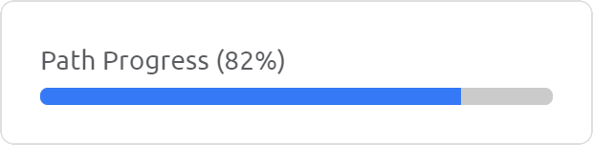





Basic - Privilege Escalation
💯 Toss a coin: Sing with me this amazing song!
💯 Yer a Wizard: Find out about the secret wizarding school!
💯 Musa Troglodytarum: Le bananier des montagnes
💯 Secrets of the Maw: Uncover the secrets of the maw, and don't get caught!
💯 The Binding of Cyber: Try not to lose yourself in this devilish room
Medium - CVE and SSH Tunneling
💯 Dalgona: 오징어 게임에 참여하여 456억의 당첨 기회를 잡으세요!
💯 Grand Line: I am going to be the pirate king!
💯 Silence: What does it take to climb the world’s first 9c?
💯 Un Pepene: Efectuați un test de penetrare
Room Overview
ALL ROOMS
Advanced - Realistic Boxes
🔷 Around The World: Discover the secret track of the famous duo!
⛶ Diabolical Box: Every puzzle has an answer!
⛶ Patience: Cookies are baking, wait for them to cook ... or find another way

Slide 13



Thanks
We want to extend our heartfelt gratitude for your time and attention. This project was a collaborative effort filled with challenges and learning experiences that significantly enhanced our cybersecurity skills. We hope our walkthroughs and insights will be valuable to you in your own journey. Special thanks to TryHackMe for providing such an engaging and educational platform. We also appreciate the support from our peers. Thank you for being part of our journey, and we look forward to continuing to explore the fascinating world of cybersecurity together. (no)
Contact
https://github.com
Feel free to explore each room and enhance your skills in cyber security. Happy hacking
https://tryhackme.com

